Slide 1
High Injury Corridors
Oregon Metro Region

Slide 2
Introduction
The 2012 State of Safety report identified factors contributing to high severe crash rates in the region:
Arterial roadways, Multi-lane roadways, Lack of lighting, Behavioral factors
Lacked ability to quantify risk by specific roadway
The 2012 RTSP recommended development of performance measurements to identify high-crash arterials in the region.
Notes:
How will the tool be used?
How does the work group think it should be used.

Slide 3
Introduction
The Regional High Injury Network (HIN) is an objective quantitative assessment of the crash performance of every roadway.
Quantifies the concentrations of severe crashes (by mode) involving a motor vehicle.
Identifies the corridors hosting the most severe crashes.
Could inform policy approaches to improve safety.
Notes:
How will the tool be used?
How does the work group think it should be used.

Slide 4
Methodology
ODOT Crash data: 5-year window, 2010-2014
Analysis Area: Metropolitan Planning Area
Create Corridors
Combine consecutive streets with the same name and highway direction
Remove corridors < ¼ mile
Divide corridors > 3 miles
Analyze Crashes
Weight crashes by severity of injury and mode (see table)
Summarize weighted crashes for each corridor
Normalize the crash score by the length of the corridor
Crash Type Weighting Values
Type | Auto | Bike | Ped.
Fatal | 10 | 10 | 10
Severe | 10 | 10 | 10
Mod. | 0 | 3 | 3
Minor | 0 | 3 | 3
PDO | 0 | 1 | 1

Slide 5
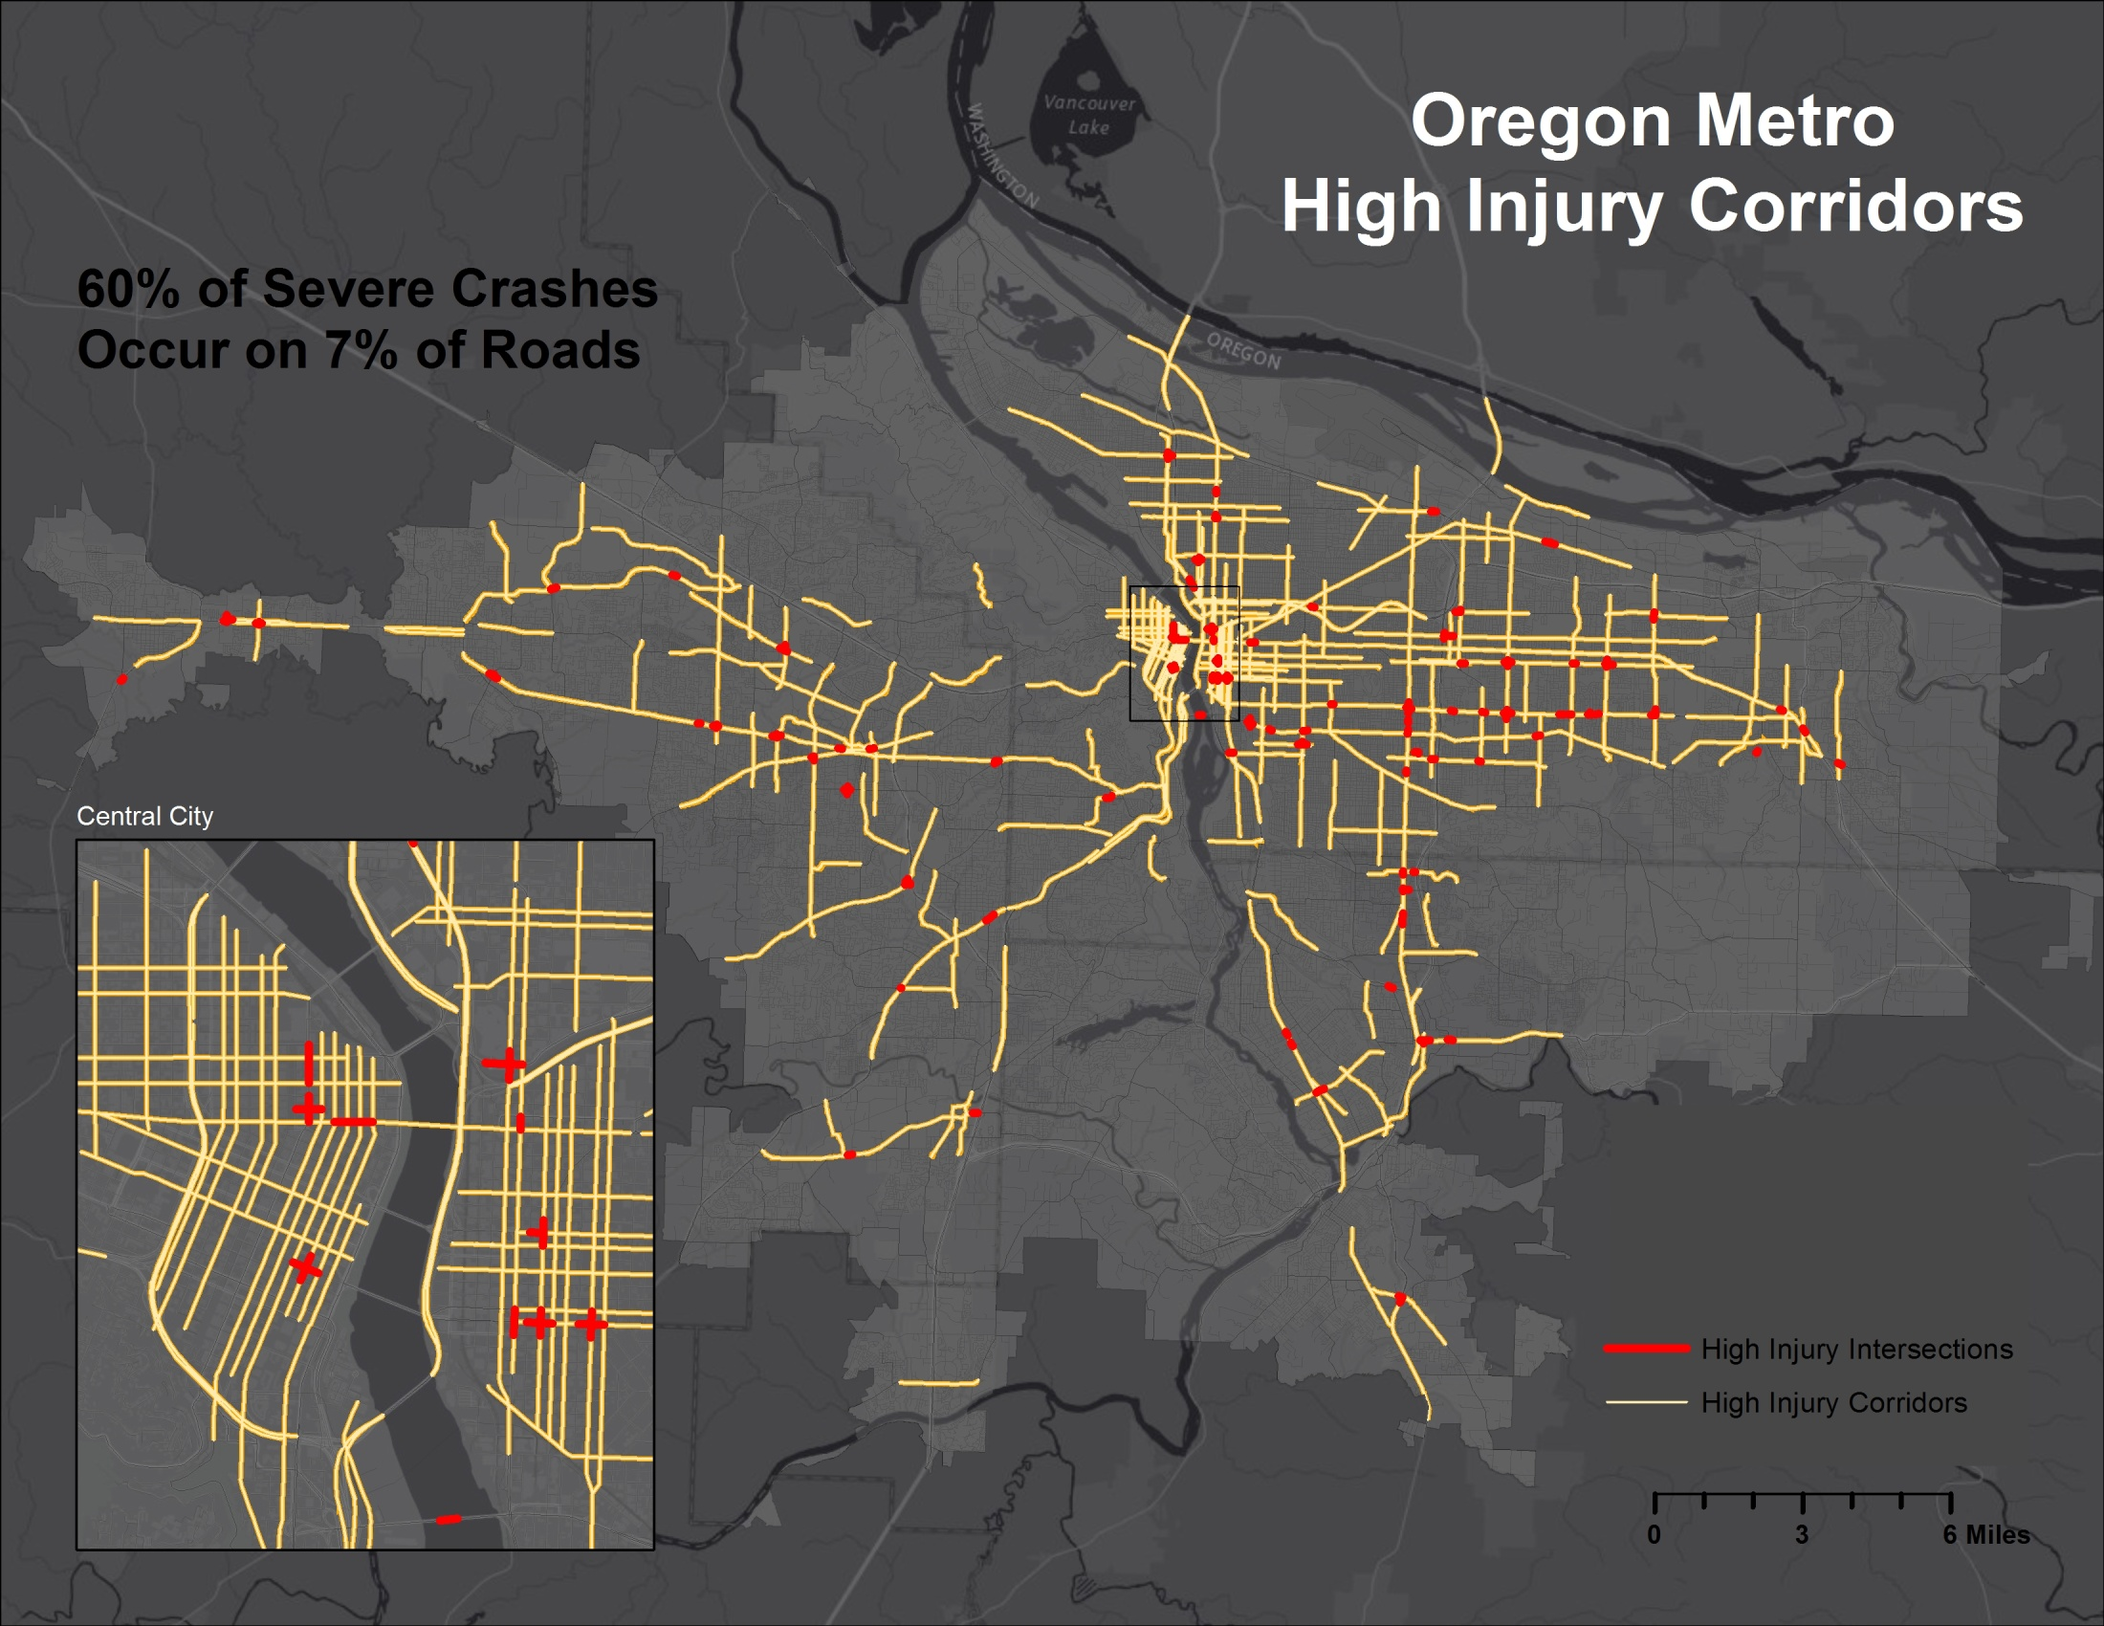

Slide 6
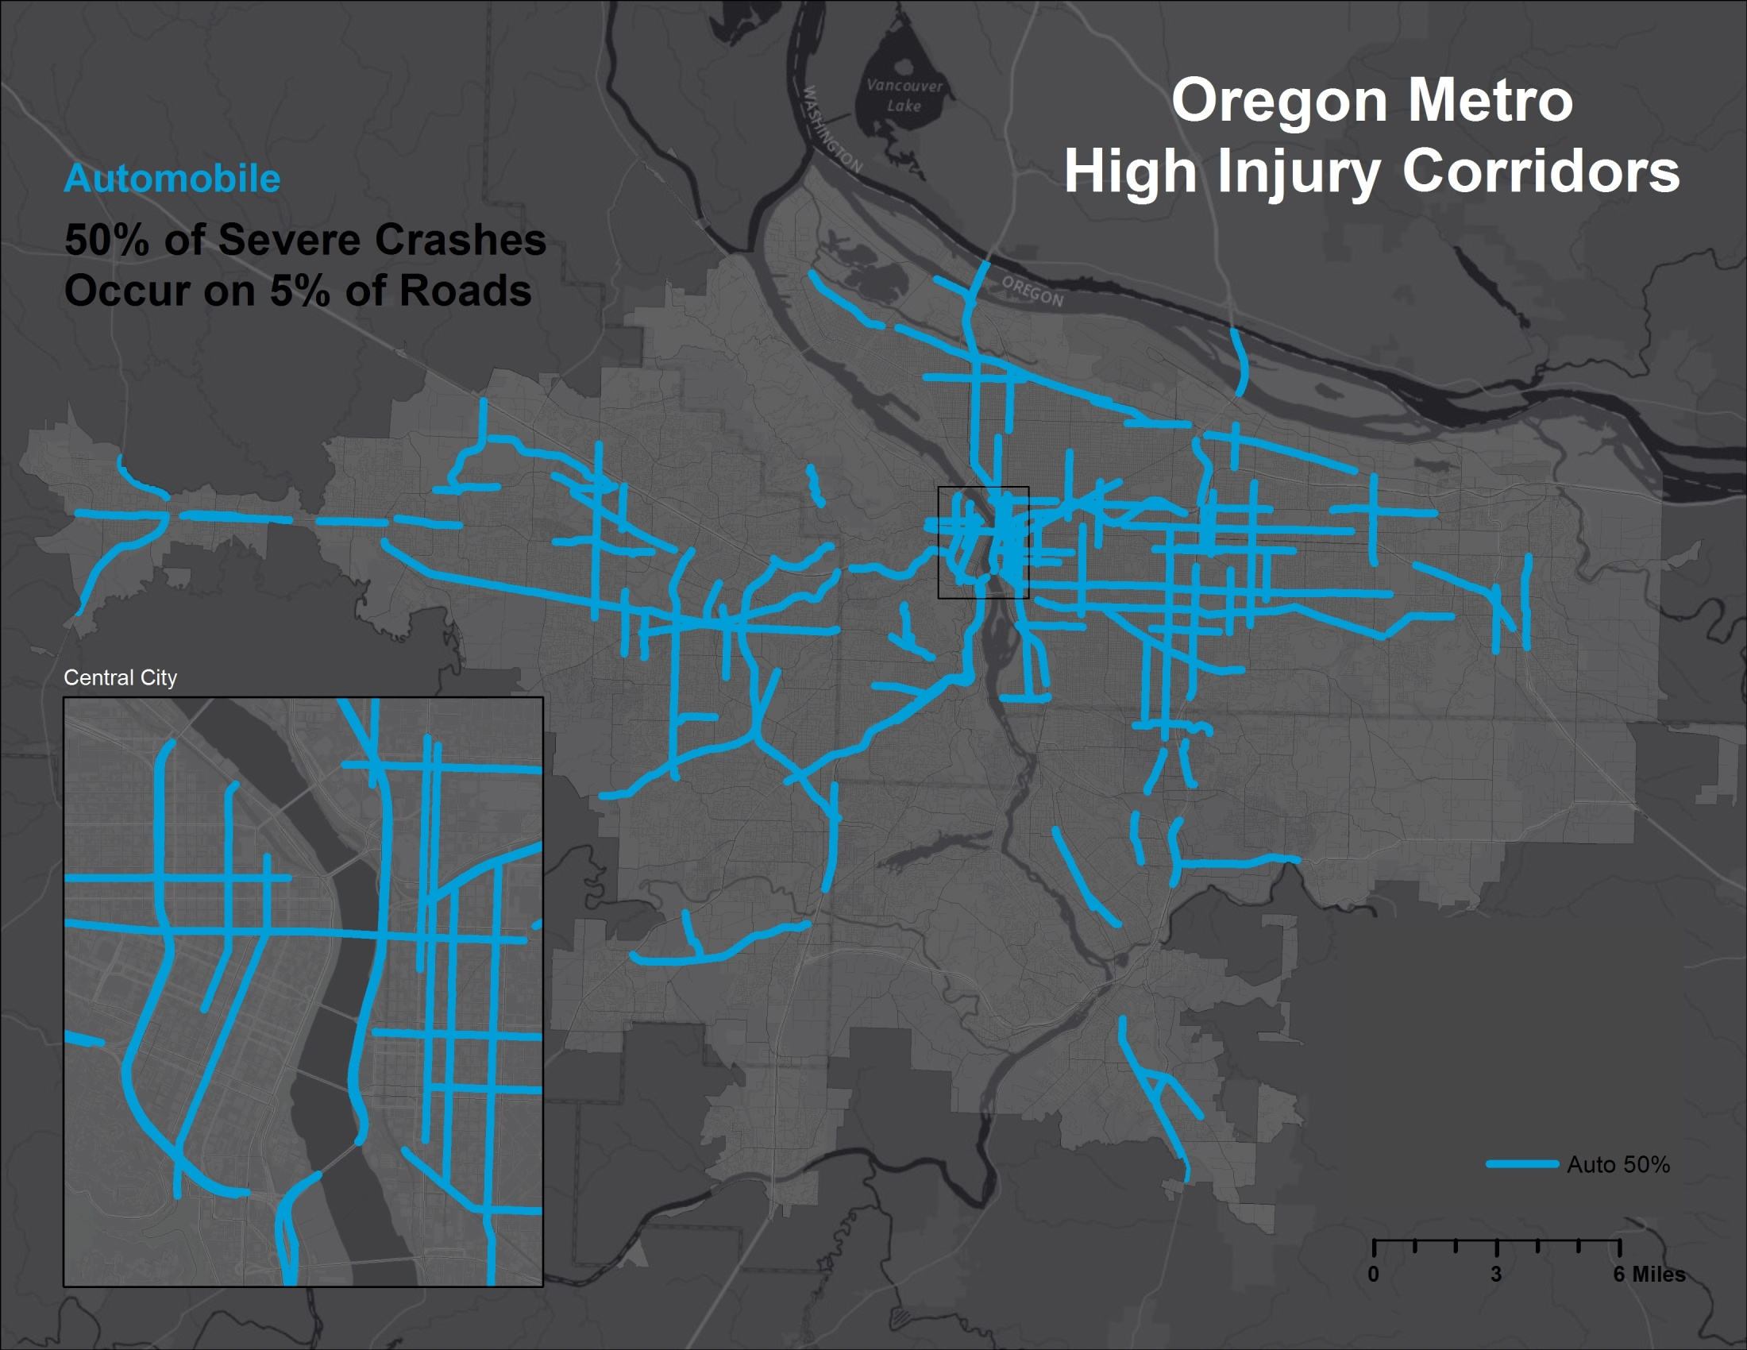

Slide 7
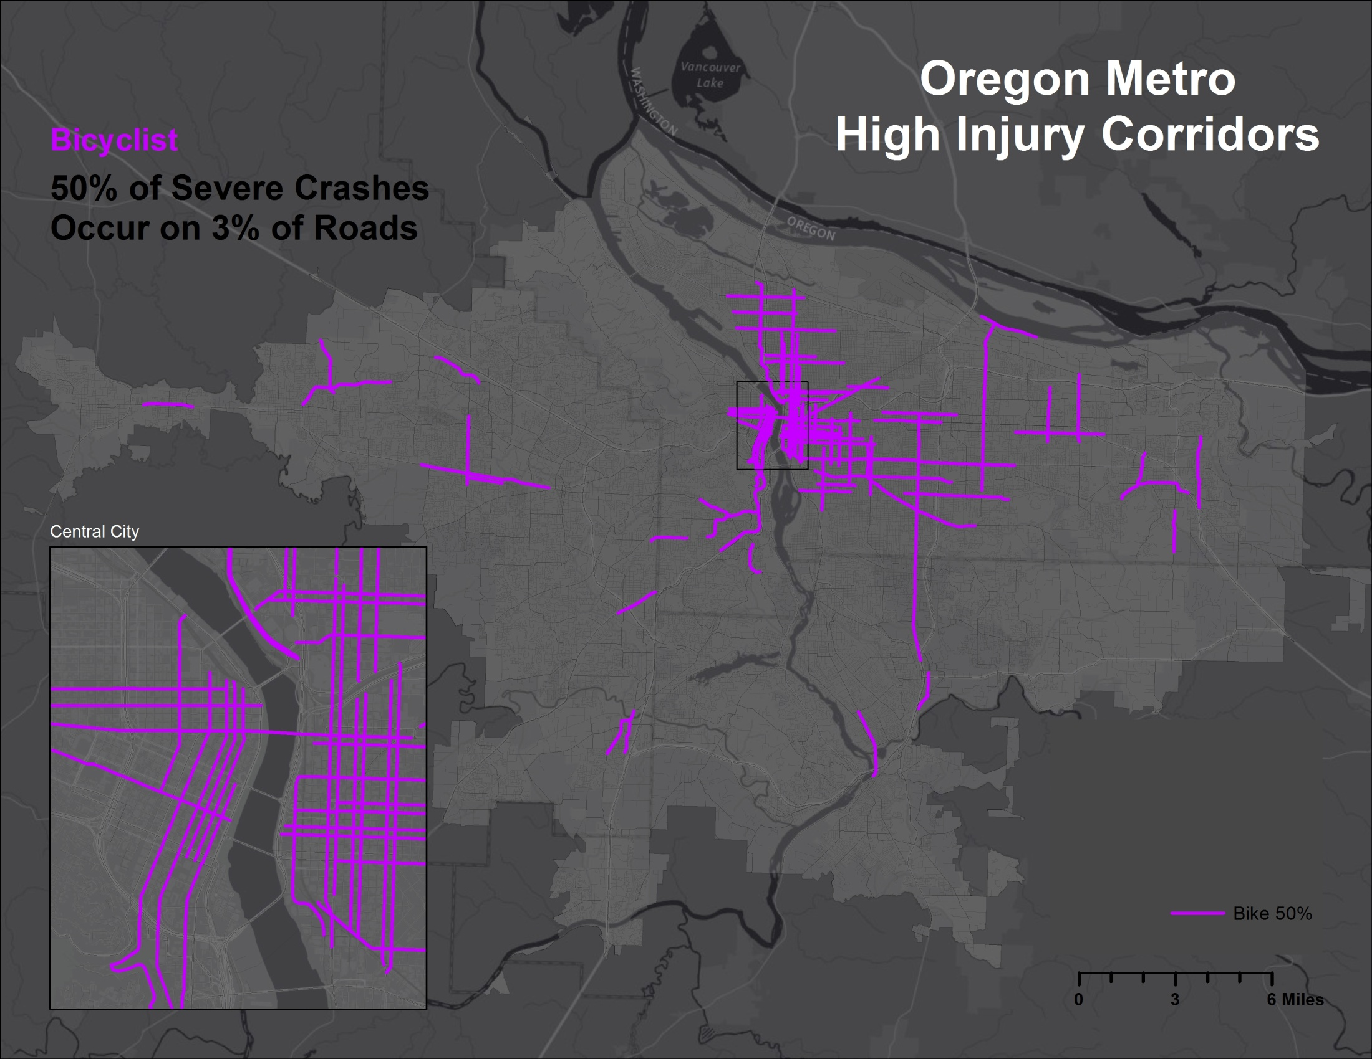

Slide 8
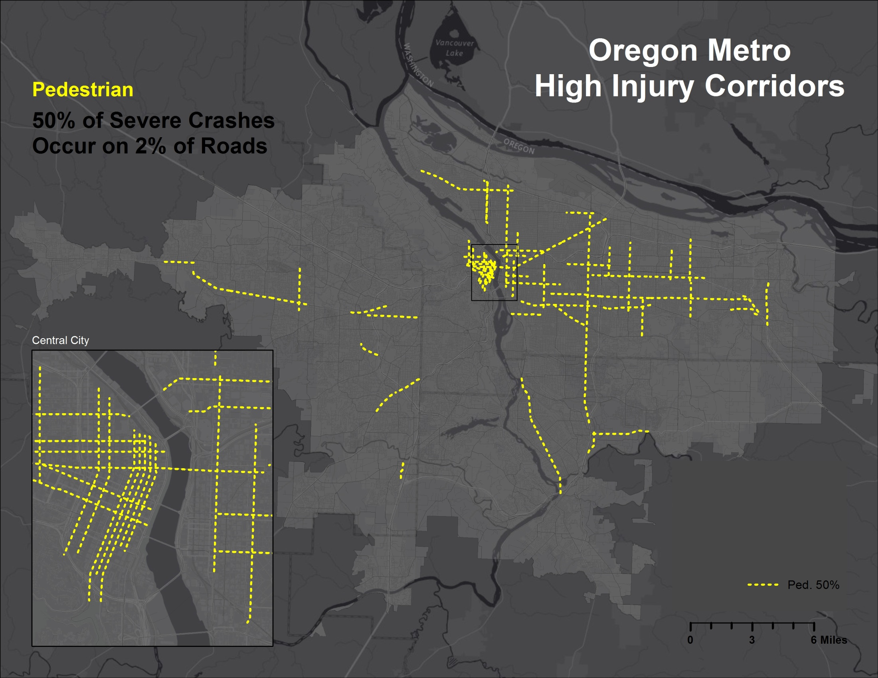

Slide 9
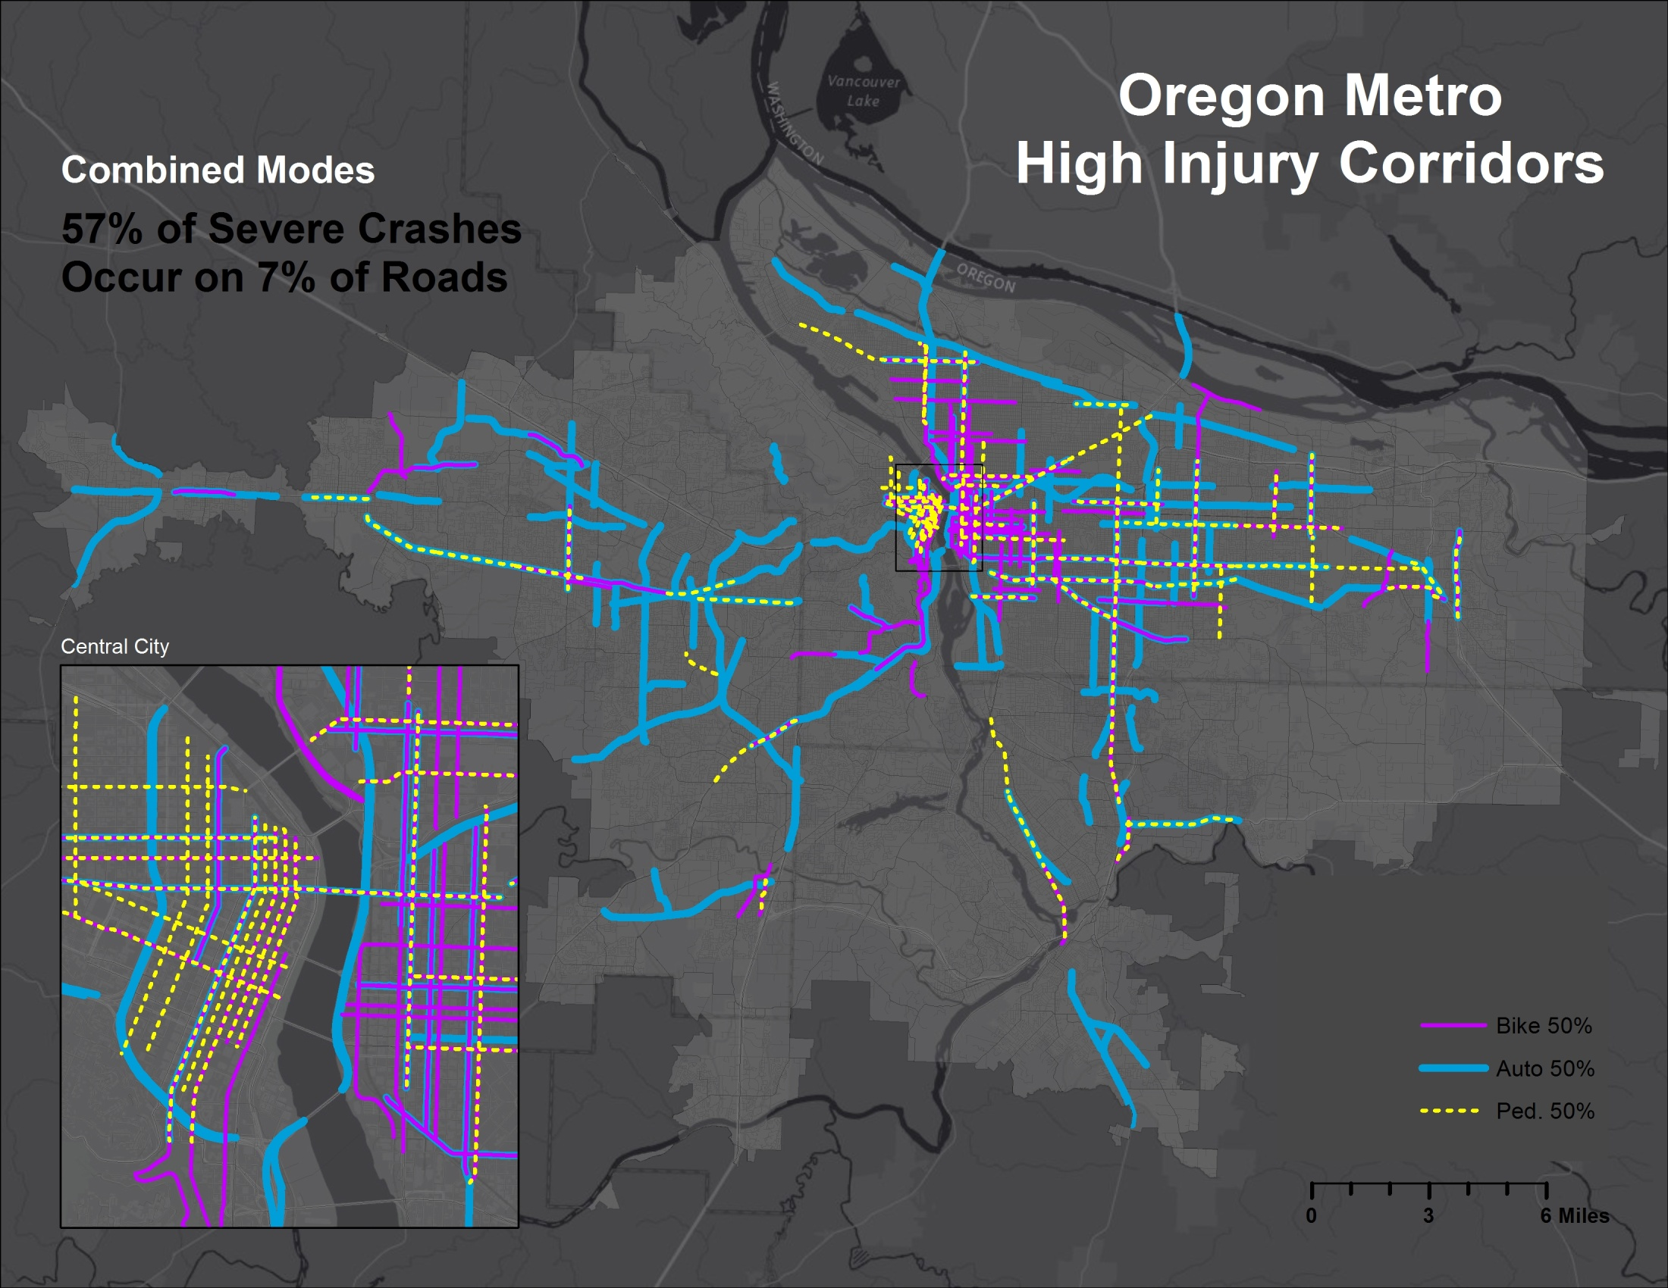

Slide 10
Corridor Stats
6,565 miles of roads within the Metropolitan Planning Area
Mode | Severe Crashes* | 70% Severe Crashes | 60% Severe Crashes | 50% Severe Crashes
All | 2,259 | 665 mi / 10% | 472 mi / 7% | 331 mi / 5%
Auto | 1,777 | 579 mi / 9% | 422 mi / 6% | 298 mi / 5%
Bike | 161 | 330 mi / 5% | 241 mi / 4% | 177 mi / 3%
Ped. | 368 | 300 mi / 5% | 209 mi / 3% | 138 mi / 2%
* severe crashes are those that result in fatality or debilitating injury

Slide 12
Weighting Crashes
Based on the State of Safety Report (2012, iii):
“A regional arterial safety program to focus on
corridors with large numbers of serious crashes,
pedestrian crashes, and bicycle crashes.”
Type | Fatal | Severe | Moderate | Minor | PDO
Auto | 10 | 10 | 0 | 0 | 0
Ped | 10 | 10 | 3 | 3 | 1
Bike | 10 | 10 | 3 | 3 | 1

Slide 13
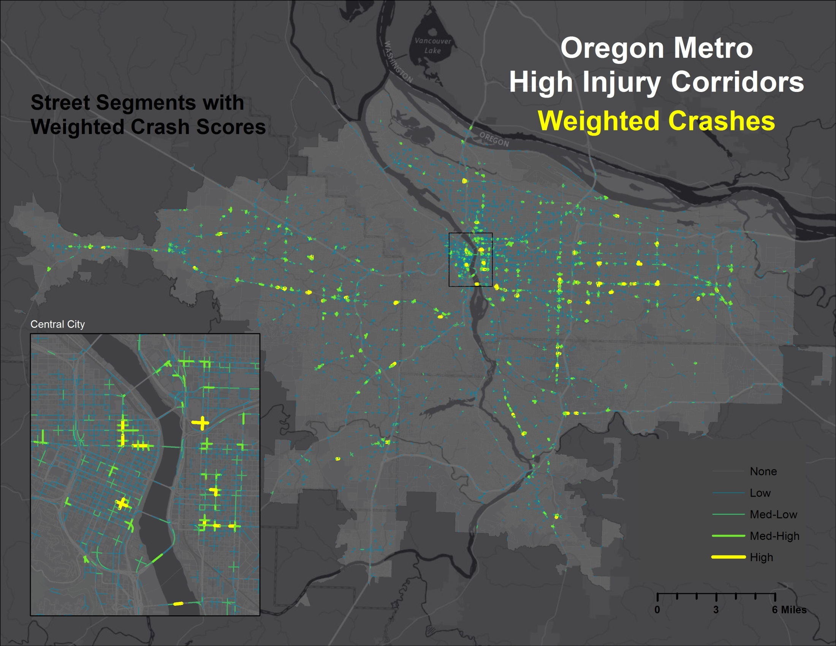

Slide 14
Corridor Identification
Combine consecutive streets with the same name and highway direction
Split at the midpoint streets that are greater than a specified length
Add weighted crash totals
Normalize the crash scores by the length of the corridor

Slide 15
Mode Comparison
Combine the top corridors from each mode (auto, bike, and ped) that represent at least 50% of fatal and severe crashes
Dissolve the merged corridors by the UID and summarize the normalized crash scores
Resulting corridors contain a count for each street segment with the number of modes (1, 2, or 3)

Slide 16
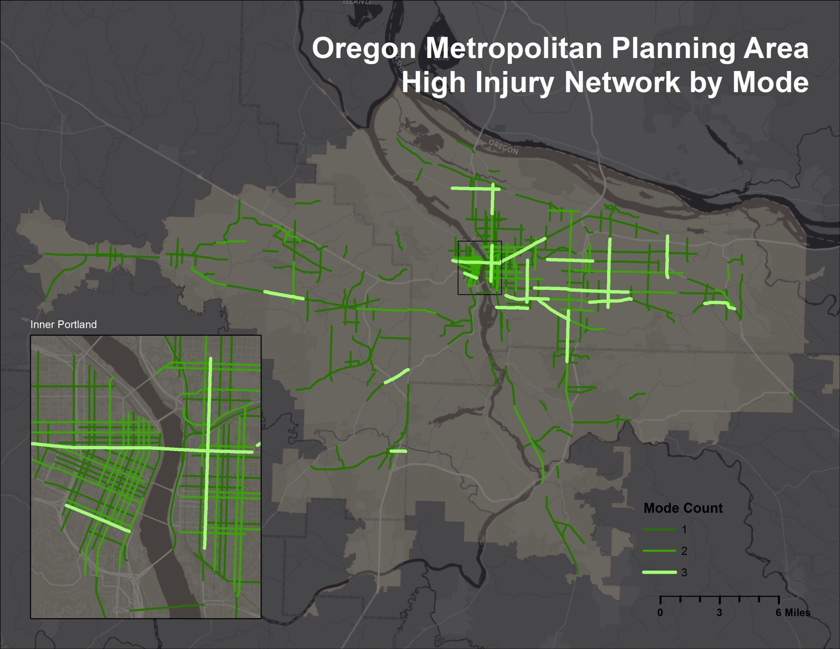

Slide 17
Overall Top 40 High Injury Corridors
SW Broadway
W Burnside
NE Broadway
NE Grand
SE 82nd
SE Division
NW 3rd
SE 7th
NE MLK Jr.
SE Division
SW Tualatin Valley
SE Powell
SW Pacific
NE Couch
SE 82nd
NE Burnside
NE 102nd
NW Everett
SE Foster
SW Naito
SE Division
NE Glisan
NE 181st
NE Lloyd
SE Hawthorne
SE McLoughlin
SE 122nd
SW 4th
SW Market
SW 2nd
NE MLK Jr.
SE Powell
SE 11th
SW Allen
SE 82nd
Ross Island Bridge
SE Powell
SW Nyberg
SW Cedar Hills
NE Multnomah

Slide 18
Top High Injury Corridors: All Modes
Burnside (NW 24th Pl./SE 14th Ave.)
Grand (SE Stephens St./NE Schuyler St.)
SE Division (SE 46th Ave./SE 142nd Ave.)
SW Tualatin Valley (SW 214th Ave./SW 174th Ave.)
SE Powell (SE 21st Ave./SE 61st Ave.)
SW Pacific (SW Greenburg Rd./SW Coronado St.)
SE 82nd (SE Otty St./SE Holgate Blvd.)
SE Foster (SE Powell Blvd./SE 82nd Ave.)
NE Glisan (NE 60th Ave./NE 105th Ave.)
181st (SE Yamhill St./NE Sandy Blvd.)
122nd (SE Boise St./NE Stanton St.)
SW Market (SW 13th Ave./SW Naito Pkwy)
NE MLK Jr. (NE Alberta St./NE Columbia Blvd.)
SE Powell (SE 102nd Ave./SE 145th Ave.)
SW Nyberg (SW Martinazzi Ave./SW 65th Ave.)
Powell (NW Ava Ave./Hwy 26)
Cesar E. Chavez (SE Francis St./NE Flanders St.)
NE Sandy (NE Couch St./NE 56th Ave.)
Lombard (N Seward Ave./NE 10th Ave.)
SE Holgate (SE McLoughlin Blvd./SE 40th Ave.)

Slide 19
High Crash Score Corridors: 2 Modes
Auto + Bike
Auto + Pedestrian
Bike + Pedestrian
NE Grand
SE 7th
NE MLK Jr.
SW Pacific
NE 181st
NE Lloyd
SE 11th
NW 9th
SE Clay
SE 82nd
SE Division
SW Tualatin Valley
SW Pacific
NE 102nd
NE Glisan
SE McLoughlin
SE Powell
NE 82nd
SW Broadway
NW 3rd
SW Pacific
SE Hawthorne
SW 4th
NE MLK Jr.

